Slide 1

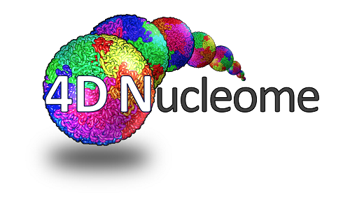


Genomic Technologies for studying 3D Genome Organization
David Gorkin, PhD
Laboratory of Dr. Bing Ren
University of California San Diego
Ludwig Institute for Cancer Research
3D Genome Organization and Chromatin Interactions Workshop
ASHG 2017

Slide 2


3D Genome Organization is Integral to Genome Function
~2 Meters!
Enhancer
Promoter
Gene ON
X-chromosome inactivation
DNA Replication
DNA repair
Engreitz et al., Science. 2013
Pope et al., Nature. 2014
Misteli & Soutoglou, Mol Cell Biol. 2009

Slide 3

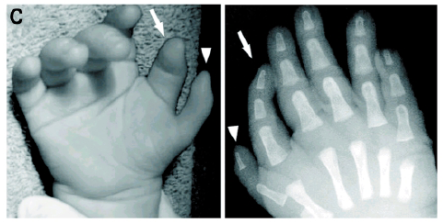
3D Genome Organization and Human Disease
Enhancer
Promoter
Gene ON
Congenital Malformations
Cancer
Gene OFF
Oncogene OFF
Normal
Normal
Gene ON
Oncogene ON
Pathogenic
Rearrangements
Pathogenic
Methylation or
Microdeletions
Flavahan et al. Nature. 2015;
Hnisz et al. Science. 2016
Lettice et al., PNAS. 2002
Sagai et al., Development. 2005
Lupiáñez et al. Cell. 2015;
Franke et al., Nature. 2016

Slide 4
Using Proximity Ligation to Assay 3D Genome Organization
Dekker et al., Science.2002
Figures adapted from:
Rao et al., Cell. 2014
Gorkin et al. Cell Stem Cell 2013

Slide 5
Many variations on the concept of Proximity Ligation
Restriction enzyme digest
(or other fragmentation)
Crosslinking
Ligation
DNA purification
Vantage
Point
ChIA-PET,
HiChIP, PLAC-seq
View
3C
“one-vs-one”
4C-seq
“one-vs-all”
Capture C, 5C
Hi-C
“all-vs-all”
“many-vs-many”, or “many vs all”
PCR
Inverse PCR &
sequencing
Target capture & Seq,
Multiplexed LMA & Seq
Sequencing
Sequencing
Readout
Figure adapted from Dekker, Marti-Ronom, and Mirny. Nat Rev Genet. 2013

Slide 6
4C-seq data: “one vs all”
Vantage Point
Van de Werken et al. Nat Methods. 2012

Slide 7
ChIA-PET, HiChIP, PLAC-seq: “many-vs-many”, or “many-vs-all”
Proximity Ligation + IP for protein of interest
HiChIP: Mumbach et al. Nat Methods. 2016
PLAC-seq: Fang, Yu, et al. Under review.
(bioRxiv 074294; doi: http://dx.doi.org/10.1101/074294)
Y
Y
HiChIP,
PLAC-seq
ChIA-PET
Mumbach et al. Nat Methods. 2016

Slide 8
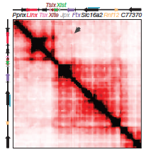
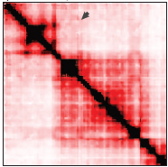

Hi-C data: “all-vs-all”
Lieberman-Aiden, et al. Science. 2009, Rao et al. Cell. 2014
Hi-C
High throughput Chromatin Conformation Capture
Rotate
45°
Hi-C
Interaction Frequency
Restriction enzyme
6-cutter (~5Kb)
4-cutter (~250bp)
Sequencing depth
~300-500M pairs standard (40Kb)
~1B+ pairs “high-res” 10Kb+
High
Low
Factors that determine resolution
…
…
R1
R2
R3
Topologically Associating Domains (TADs)
Nora et al. Nature. 2012
Dixon et al. Nature. 2012

Slide 9
A bit more about Topologically Associating Domains (TADs)
Genome is organized into ~2000 TADs (1-2Mb)
Highly consistent between cell types
CTCF & other mechanisms maintain boundaries
Highly conserved from mouse to human
Enhancer
Promoter
Gene ON
Dixon et al. Nature. 2012

Slide 10
Topologically Associating Domains (TADs) as regulatory units
H3K9me3
Lamin-Associated
Domains (LADs)
H3K27me3
Dixon et al. Nature. 2013
TADs constrain Enhancer-Promoter interactions
TADs divide the genome functional units that are often co-regulated
Lupiáñez et al. Trends in Genetics. 2016
Nora et al. Bioessays. 2013

Slide 11
Summary
3D Genome is Integral to genome function & gene regulation.
Proximity ligation has given rise a series of genomic technologies to assay 3D genome organization.
  Differ in scope, scale, and resolution.
Key discovery: The interphase genome is organized into TADs
  Important to consider TADs when thinking about the consequences of structural and non-coding mutations (or variants).

Slide 12
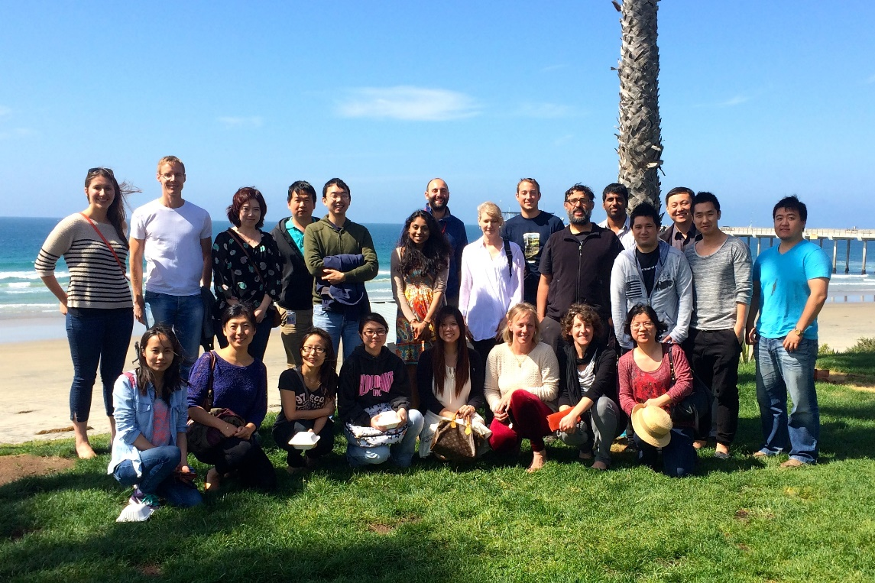

Acknowledgements
ENCODE: San Diego Data Production Group
Dr. Bing Ren
Dr. Joe Ecker
Dr. Len Penacchio
Dr. Axel Visel
Dr. Wei Wang
4DN: San Diego 4D Nucleome Center
Dr. Bing Ren
Dr. Cornelis Murre
Dr. Ana Pombo
Dr. Olga Dudko
Dr. Mario Nicodemi
Dr. Ming Hu
Ren Group
Dr. Bing Ren
Yunjiang Qiu
Dr. Anthony Schmitt
Dr. Inkyung Jung
Dr. Siddarth Selvaraj
Dr. Jesse Dixon
Dr. Bin Li
Ah Young Lee
Zhen Ye
Samantha Kuan
1KG Collaborators
Dr. Charles Lee
Dr. Jonathan Sebat
Dr. Amina Noor
A.P. Giannini Foundation

