Slide 1
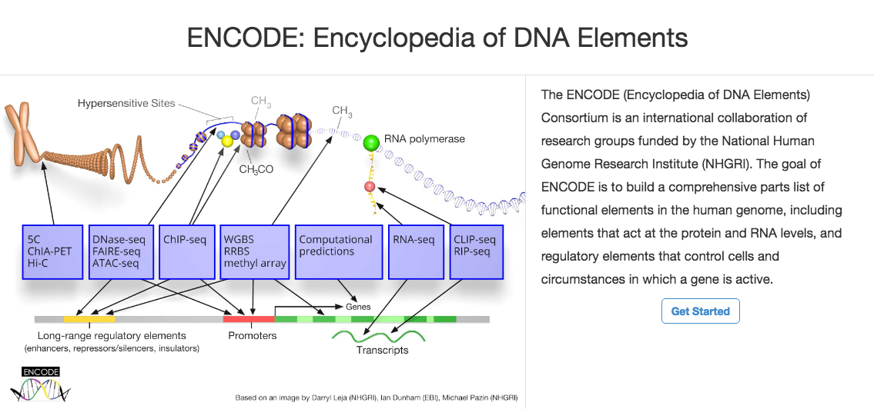


3D Genome Workshop - Overview of ENCODE
Dan Gilchrist
National Human Genome Research Institute
October 18, 2016
Notes:
s

Slide 2
3D Genome Workshop - Overview of ENCODE
The ENCODE Project
3D Data Access Through the ENCODE Portal
The ENCODE Encyclopedia
Tools for Investigating Genetic Variants

Slide 3
ENCODE Tutorials
ENCODE Tutorials
https://www.encodeproject.org/tutorials/
http://www.genome.gov/27553900

Slide 4
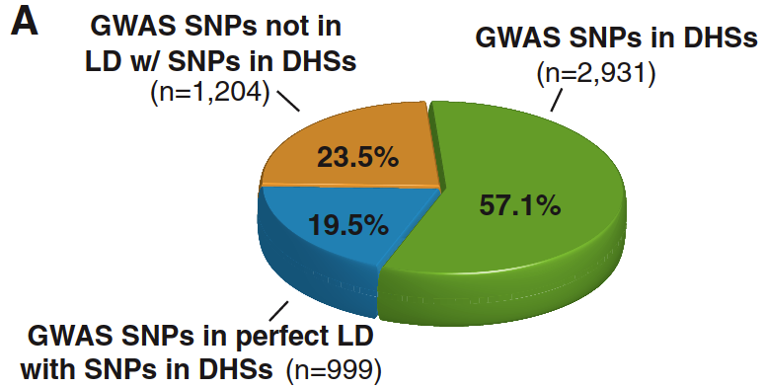
ENCODE: Annotating the non-coding genome
Vast majority of common disease associations and heritability lie outside of coding regions
Non-coding variants known to cause human diseases and alter human traits (FXS, ALS)
Stamatoyannopoulos, Science 337:1190, 2012

Slide 5
Goals of ENCODE
Identify all candidate functional elements in the human and mouse genomes
Promoters, enhancers, transcribed regions
Make resource freely available to the community for use in studies of:
Genetic basis of disease
Gene regulation
Computational tool development

Slide 6
ENCODE Data Types
1000s of data sets
100s of biosamples

Slide 7
3D Genome Workshop - Overview of ENCODE
The ENCODE Project
3D Data Access Through the ENCODE Portal
The ENCODE Encyclopedia
Tools for Investigating Genetic Variants

Slide 8
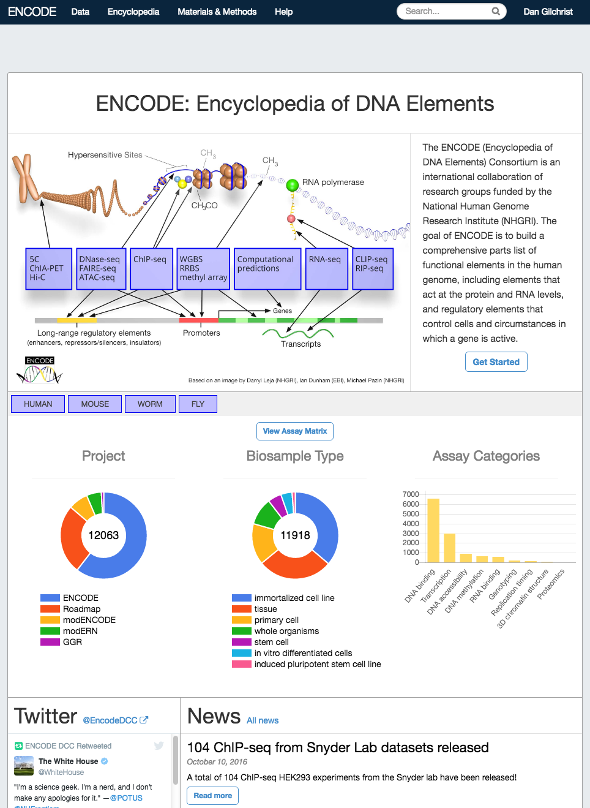
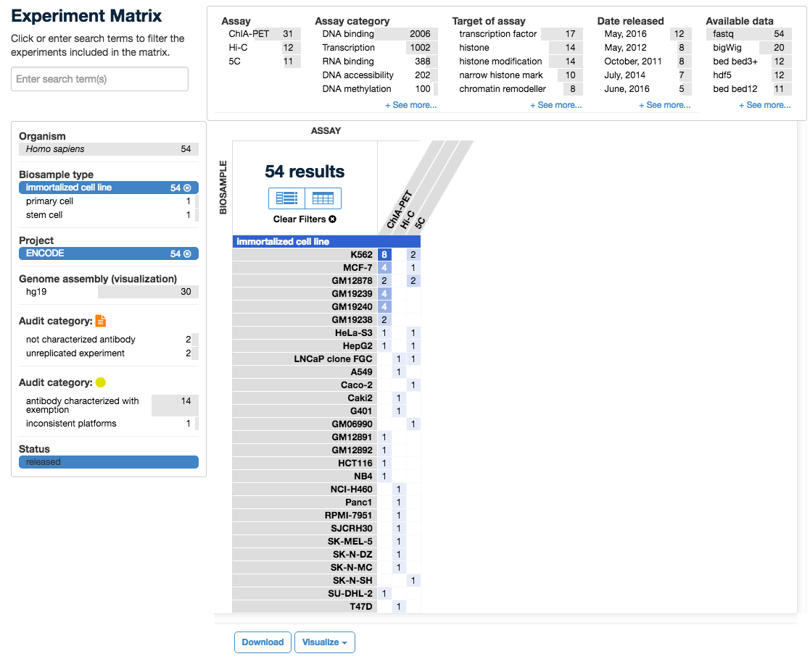
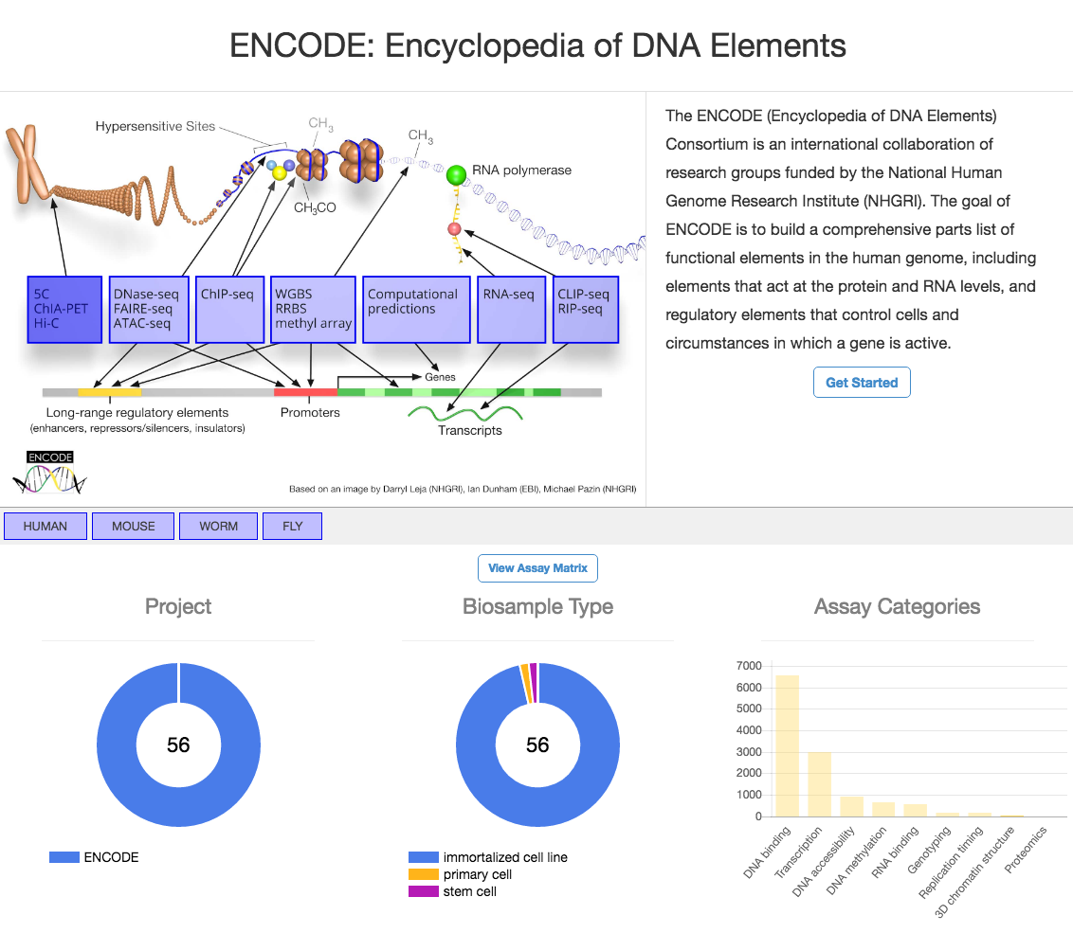
ENCODE Portal – Unrestricted data access
Select data sets
Click to download or visualize
Data also available through programatic web services
https://encodeproject.org

Slide 9
3D Genome Workshop - Overview of ENCODE
The ENCODE Project
3D Data Access Through the ENCODE Portal
The ENCODE Encyclopedia
Tools for Investigating Genetic Variants

Slide 10
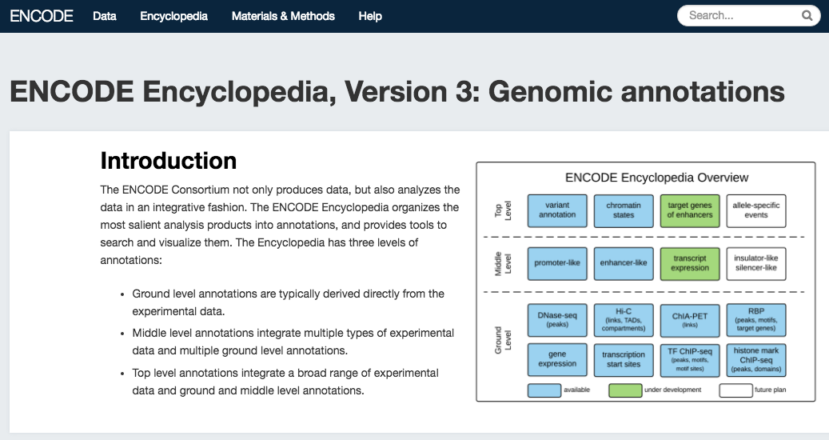
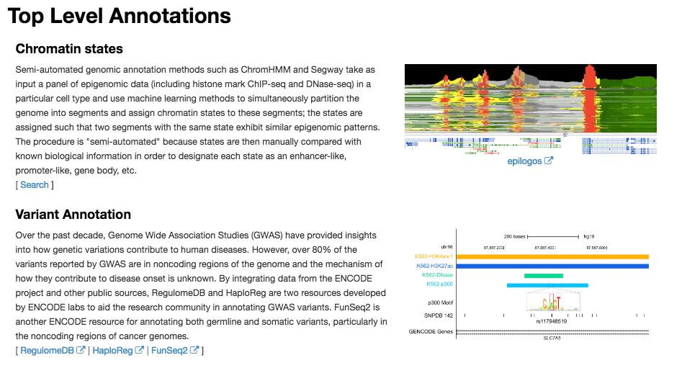
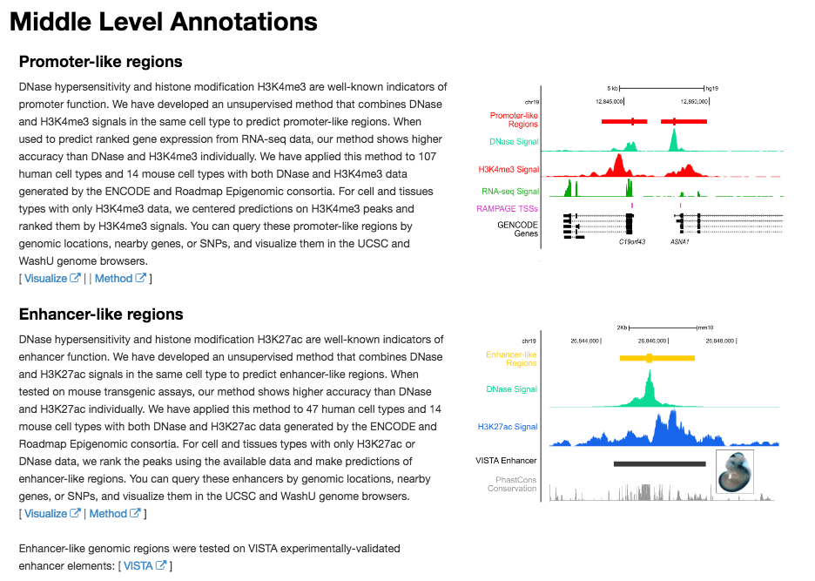
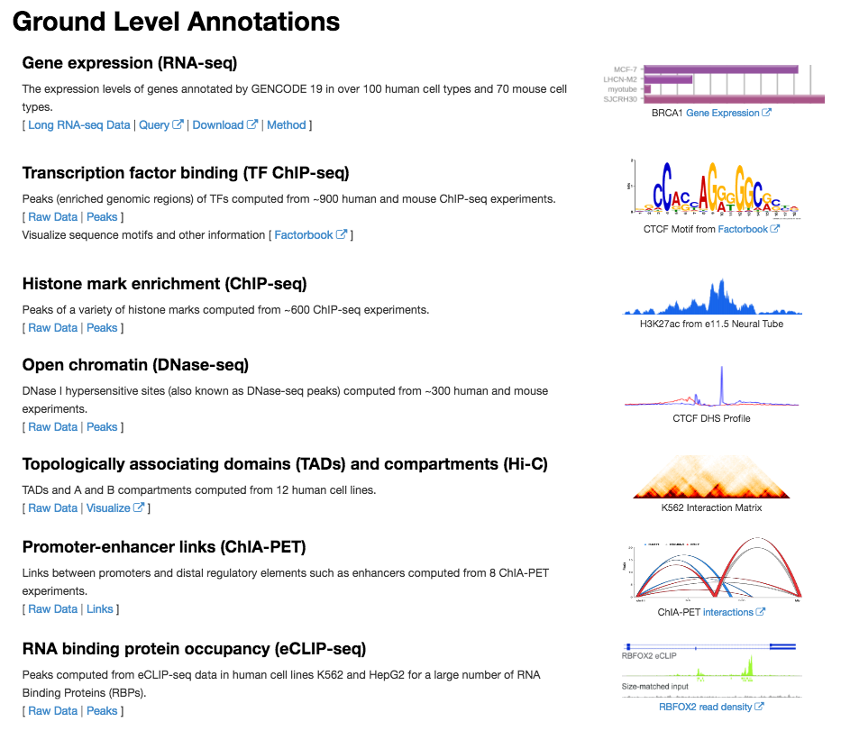
ENCODE Annotations – the Encyclopedia

Slide 11
3D Genome Workshop - Overview of ENCODE
The ENCODE Project
3D Data Access Through the ENCODE Portal
The ENCODE Encyclopedia
Tools for Investigating Genetic Variants

Slide 12
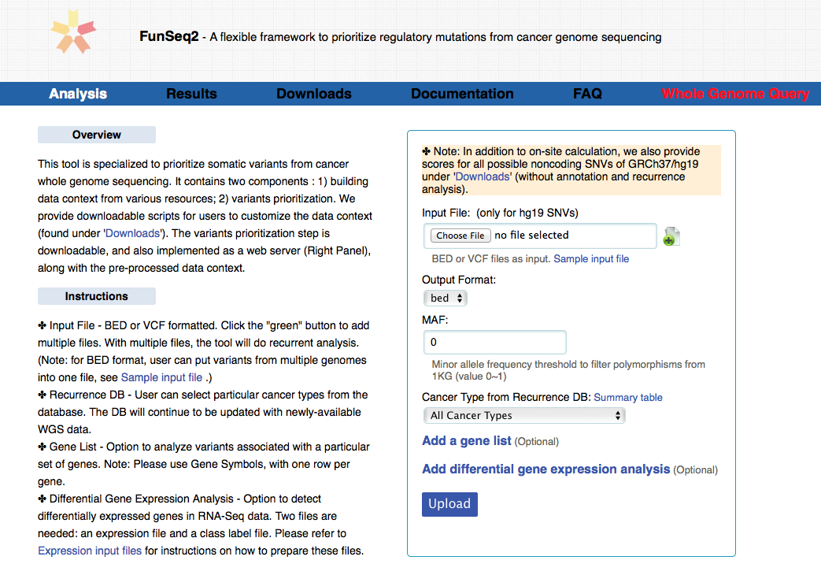
Tools for Variant Annotation – FunSeq2
http://funseq2.gersteinlab.org/
Fu, Khurana, Gerstein, Genome Biology (15)10 2014

Slide 13
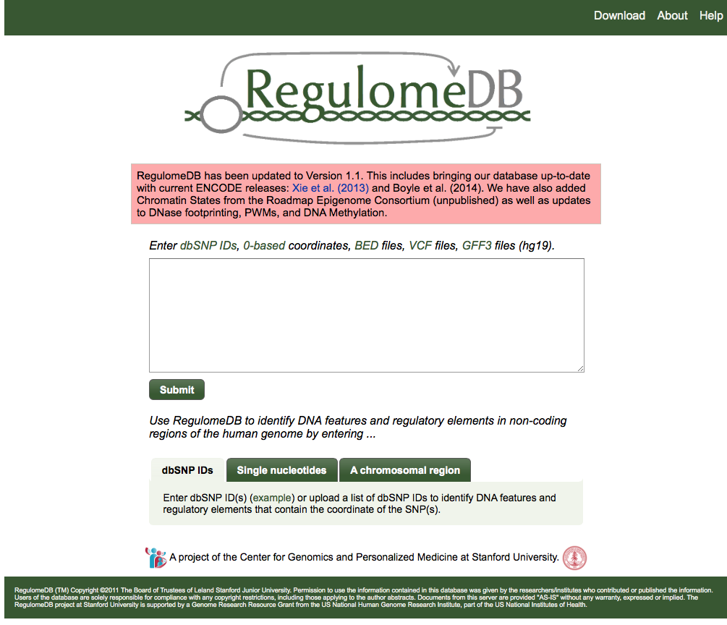
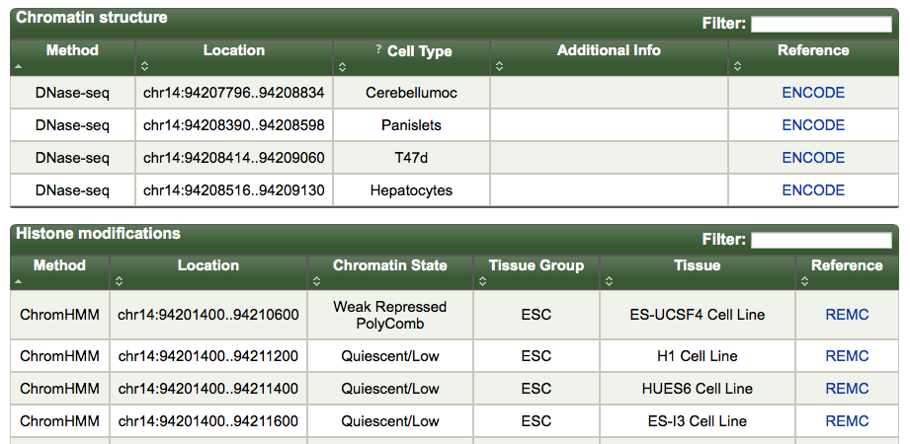
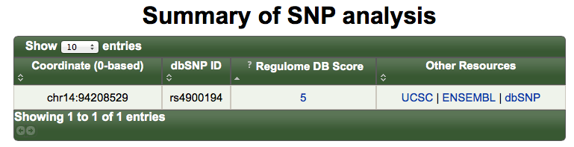
Tools for Variant Annotation - RegulomeDB
http://regulomedb.org/
Boyle, Cherry, Snyder, Genome Research 22-1790,2012

Slide 14
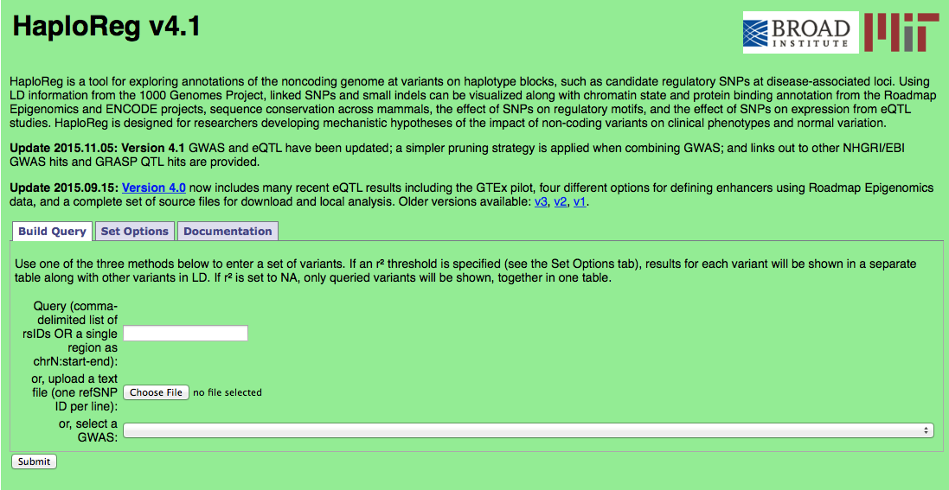
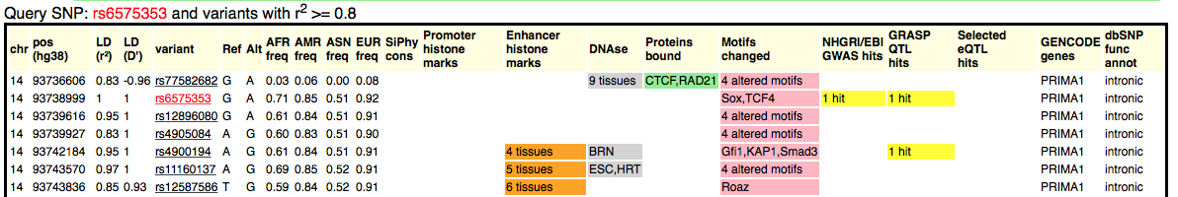
Tools for Variant Annotation - HaploReg
www.broadinstitute.org/mammals/haploreg/
Ward and Kellis, Nucleic Acids Research 40-D930, 2011

Slide 15
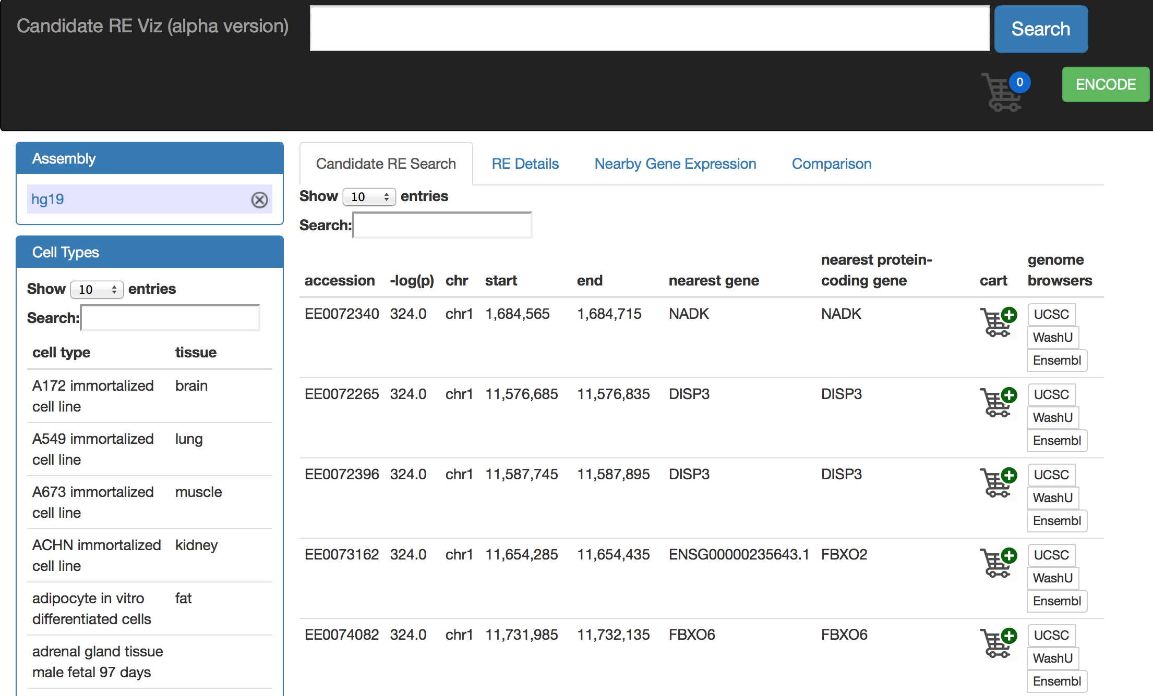
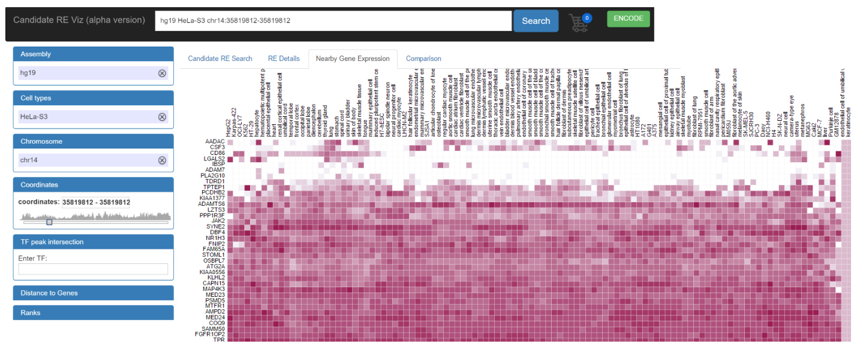
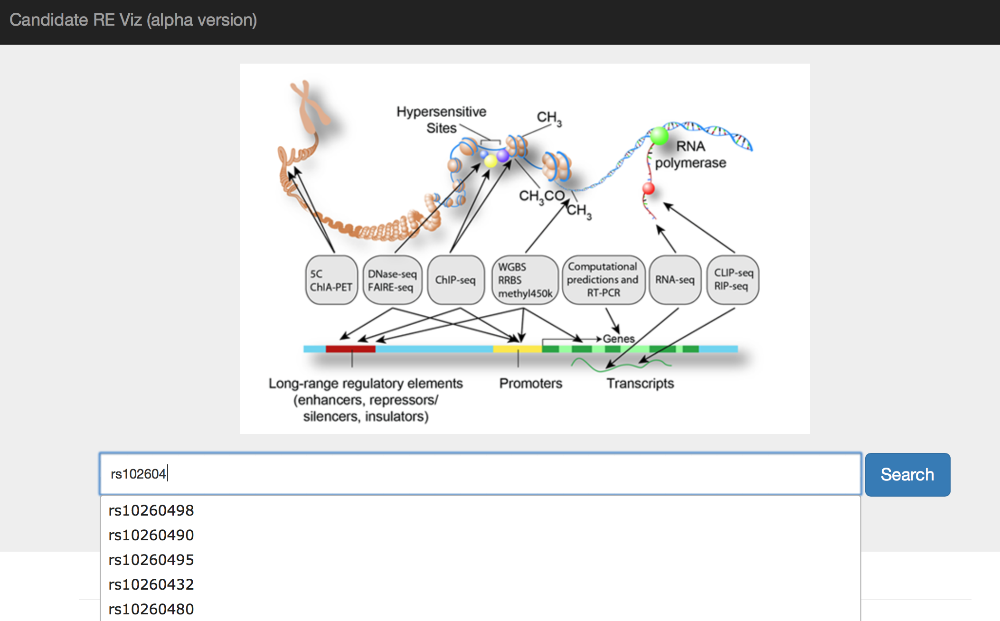
Coming soon – ENCODE Element Visualizer!!!
Notes:
I’d also like to point out that a new tool will soon be available as part of the ENCODE Encyclopedia
This is the ENCODE element visualizer,
Here showing some shots of a developmental version of this tool
One can input snps of interest, or genomic regions, or genes
And use the visualizer to sort through a great deal of ENCODE data related to your snp or gene of interest
including

Slide 16
Coming soon – Next Phase of ENCODE
Starting in 2017
Element mapping in normal and disease samples
Characterizing function of candidate elements
Likely to include expanded 3D data sets

Slide 17
ENCODE at ASHG2016
Chat with ENCODE Data Coordination Center and NHGRI ENCODE Staff
NHGRI Booth #517
2 - 3 PM Thursday 10/20
ENCODE DCC Workshop - Open Science: Quality Assurance and Analysis of ChIP-seq Data Using the ENCODE Uniform Processing Pipeline
Ballroom B
7:15 AM Friday 10/21

Slide 18
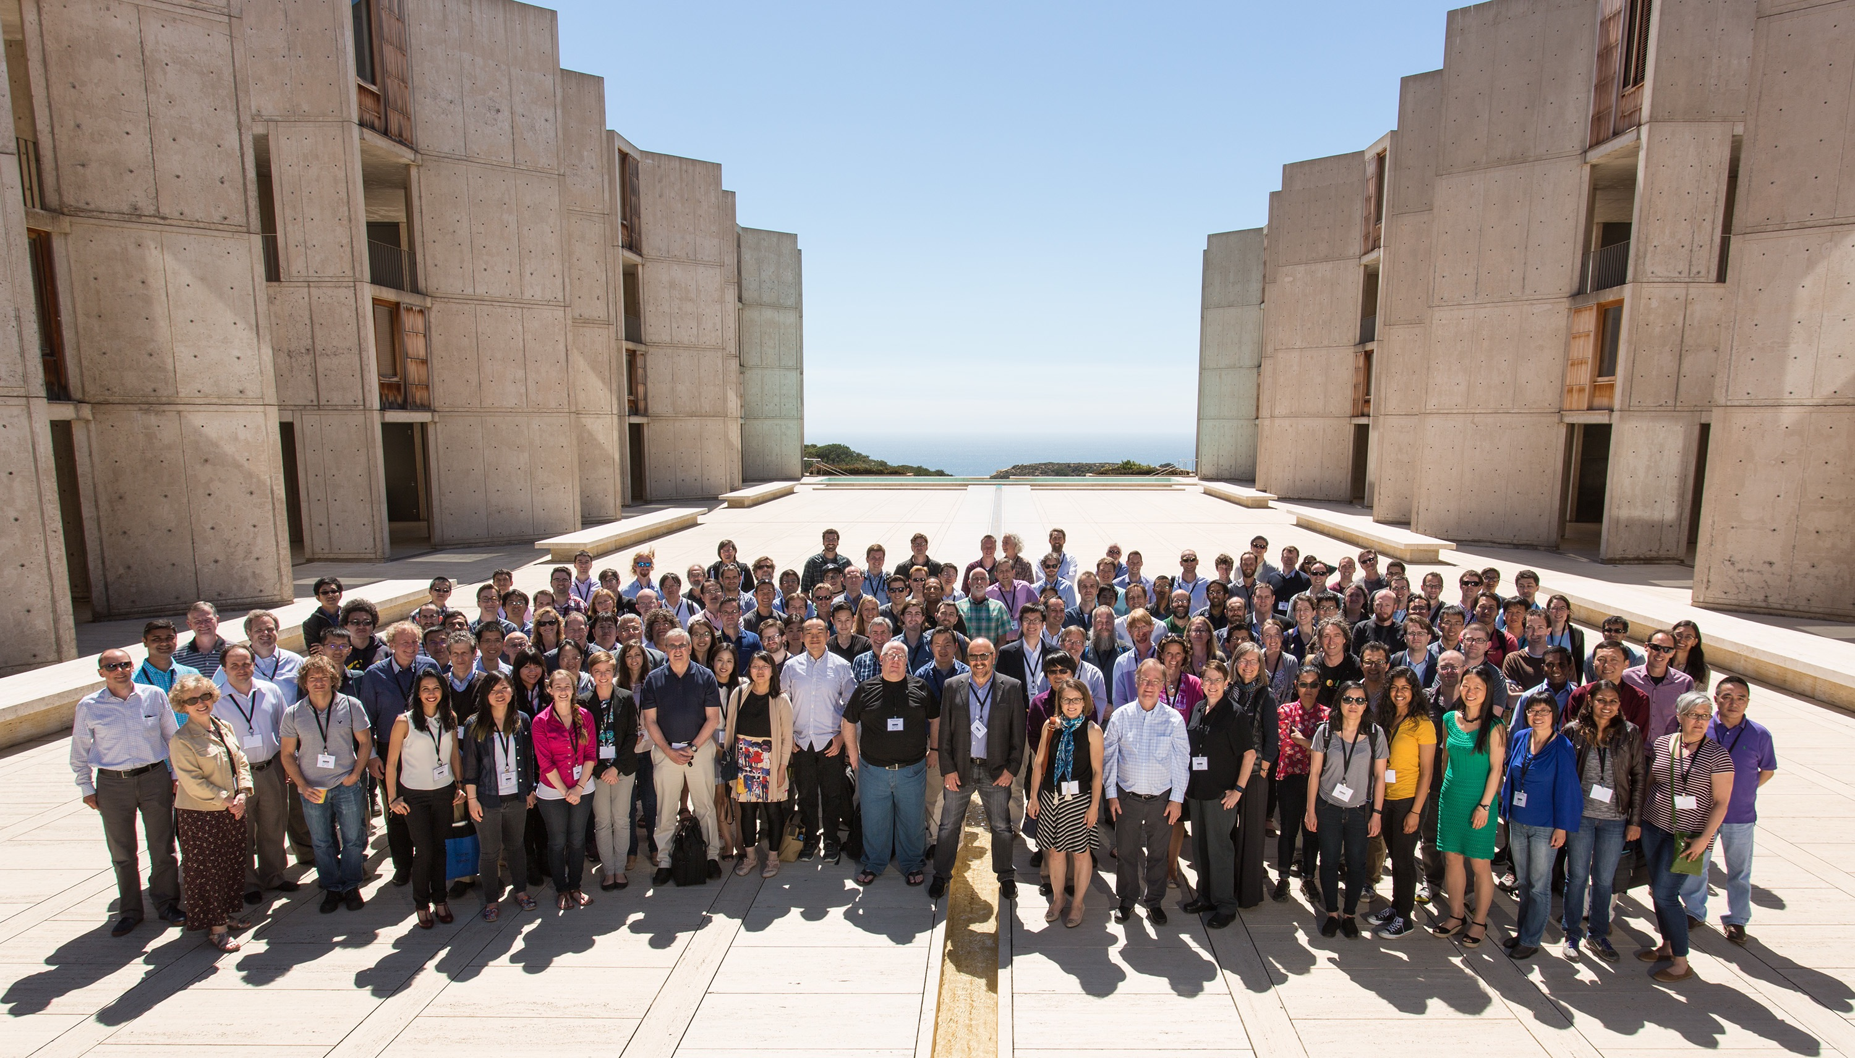


ENCODE Project Participants
Elise Feingold
Mike Pazin

